Slide 1

Introduction to MACHINE LEARNING: module 1 The basics of data Science.
Fosca Giannotti
Revisited slides from Lecture Notes for Chapter 2 “Introduction to Data Mining”, 2nd Edition by Tan, Steinbach, Karpatne, Kumar, with insertion from other recommended references-
Slides used within the 2021 edition of course DM&ML master Big Data Analytics, University of Pisa

Slide 2
Data Preparation & Exploration

Slide 3
Getting To Know Your Data
For preparing data for data mining task it is essential to have an overall picture of your data
Gain insight in your data
with respect to your project goals
and general to understand properties
Find answers to the questions
What kind of attributes do we have?
How is the data quality?
Does a visualization helps?
Are attributes correlated?
What about outliers?
How are missing values handled?
Do we need to extract other attributes

Slide 4
Data

Slide 5
What is Data?
Collection of data objects and their attributes
An attribute is a property or characteristic of an object
Examples: eye color of a person, temperature, etc.
Attribute is also known as variable, field, characteristic, or feature
A collection of attributes describe an object
Object is also known as record, point, case, sample, entity, or instance
Attributes
Objects

Slide 6
Types of Attributes
There are different types of attributes
Nominal (Categorical)
Examples: ID numbers, eye color, zip codes
Ordinal
Examples: rankings (e.g., taste of potato chips on a scale from 1-10), grades, height in {tall, medium, short}
Interval
Examples: calendar dates, temperatures in Celsius or Fahrenheit.
Ratio
Examples: temperature in Kelvin, length, time, counts

Slide 7
Properties of Attribute Values
The type of an attribute depends on which of the following properties it possesses:
Distinctness: = ≠
Order: < >
Addition: + -
Multiplication: * /
Nominal attribute: distinctness
Ordinal attribute: distinctness & order
Interval attribute: distinctness, order & addition
Ratio attribute: all 4 properties

Slide 8
Attribute Type
Description
Examples
Operations
Nominal
The values of a nominal attribute are just different names, i.e., nominal attributes provide only enough information to distinguish one object from another. (=, ≠)
zip codes, employee ID numbers, eye color, sex: {male, female}
mode, entropy, contingency correlation, χ² test
Ordinal
The values of an ordinal attribute provide enough information to order objects. (<, >)
hardness of minerals, {good, better, best}, grades, street numbers
median, percentiles, rank correlation, run tests, sign tests
Interval
For interval attributes, the differences between values are meaningful, i.e., a unit of measurement exists. (+, - )
calendar dates, temperature in Celsius or Fahrenheit
mean, standard deviation, Pearson's correlation, t and F tests
Ratio
For ratio variables, both differences and ratios are meaningful. (*, /)
temperature in Kelvin, monetary quantities, counts, age, mass, length, electrical current
geometric mean, harmonic mean, percent variation

Slide 9
Attribute Level
Transformation
Comments
Nominal
Any permutation of values
If all employee ID numbers were reassigned, would it make any difference?
Ordinal
An order preserving change of values, i.e., new_value = f(old_value) where f is a monotonic function.
An attribute encompassing the notion of good, better best can be represented equally well by the values {1, 2, 3} or by { 0.5, 1, 10}.
Interval
new_value =a * old_value + b where a and b are constants
Thus, the Fahrenheit and Celsius temperature scales differ in terms of where their zero value is and the size of a unit (degree).
Ratio
new_value = a * old_value
Length can be measured in meters or feet.

Slide 10
Types of data sets
Record
Data Matrix
Document Data
Transaction Data
Graph
World Wide Web
Molecular Structures
Ordered
Spatial Data
Temporal Data
Sequential Data
Genetic Sequence Data

Slide 11
Record (Tabular) Data
Data that consists of a collection of records, each of which consists of a fixed set of attributes

Slide 12
Data Matrix (vectors)
If data objects have the same fixed set of numeric attributes, then the data objects can be thought of as points in a multi-dimensional space, where each dimension represents a distinct attribute
Such data set can be represented by an m by n matrix, where there are m rows, one for each object, and n columns, one for each attribute

Slide 13
Document Data
Each document becomes a `term' vector,
each term is a component (attribute) of the vector,
the value of each component is the number of times the corresponding term occurs in the document.

Slide 14
Transaction Data
A special type of record data, where
each record (transaction) involves a set of items.
For example, consider a grocery store. The set of products purchased by a customer during one shopping trip constitute a transaction, while the individual products that were purchased are the items.

Slide 15
Graph Data
Examples: Generic graph, a molecule, and webpages
Benzene Molecule: C6H6

Slide 16
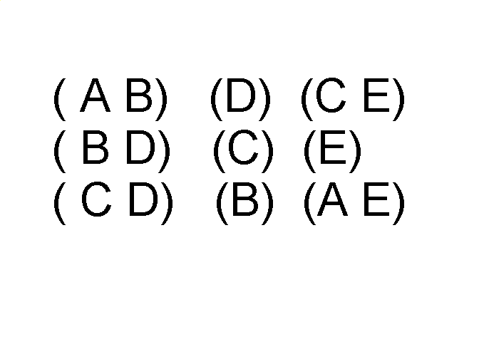
Ordered Data
Sequences of transactions
Items/Events
An element of the sequence

Slide 17
Ordered Data
Genomic sequence data

Slide 18
Ordered Data
Spatio-Temporal Data
Average Monthly Temperature of land and ocean

Slide 19
Types of Attributes
Five are different types of attributes
Nominal/Categorical: attribute values in a finite domain, categories, “name of things”
Examples: ID numbers, eye color, zip codes
Binary: Nominal attribute with only 2 states (0 and 1)
Symmetric binary: both outcomes equally important (e.g., gender)
Asymmetric binary: outcomes not equally important. (e.g., medical test positive vs. negative) The convention is to assign 1 to most important outcome (e.g., having cancer)
Ordinal: finite domain with a meaningful ordering on the domain
Examples: rankings (e.g., taste of potato chips on a scale from 1-10), grades, height {tall, medium, short}

Slide 20
Types of Attributes
Numeric: quantity (integer or real-valued)
Interval-Scaled
Measured on a scale of equal-sized units
Values have order
Examples: calendar dates, temperatures in Celsius
Ratio-Scaled: We can speak of values as being an order of magnitude larger than the unit of measurement
Examples: length, counts, elapsed time (e.g., time to run a race)
A baseball game lasting 3 hours is 50% longer than a game lasting 2 hours.

Slide 21
Discrete and Continuous Attributes
Discrete Attribute
Has only a finite or countably infinite set of values
Examples: zip codes, counts, or the set of words in a collection of documents
Often represented as integer variables.
Note: binary attributes are a special case of discrete attributes
Continuous Attribute
Has real numbers as attribute values
Examples: temperature, height, or weight.
Practically, real values can only be measured and represented using a finite number of digits.
Continuous attributes are typically represented as floating-point variables.

Slide 22
Properties of Attribute Values
The type of an attribute depends on which of the following properties/operations it possesses:
Distinctness: = ≠
Order: < >
Differences are + - meaningful :
Ratios are * / meaningful
Nominal attribute: distinctness
Ordinal attribute: distinctness & order
Interval attribute: distinctness, order & meaningful differences
Ratio attribute: all 4 properties/operations

Slide 24
Data Quality
Poor data quality negatively affects many data processing efforts
“The most important point is that poor data quality is an unfolding disaster.
Poor data quality costs the typical company at least ten percent (10%) of revenue; twenty percent (20%) is probably a better estimate.”
Thomas C. Redman, DM Review, August 2004
Data mining example: a classification model for detecting people who are loan risks is built using poor data
Some credit-worthy candidates are denied loans
More loans are given to individuals that default

Slide 25
Data Quality …
What kinds of data quality problems?
How can we detect problems with the data?
What can we do about these problems?
Examples of data quality problems:
Noise and outliers
Missing values
Duplicate data
Wrong data

Slide 26
Data exploration

Slide 27
What is data exploration?
A preliminary exploration of the data to better understand its characteristics.
Key motivations of data exploration include
Helping to select the right tool for preprocessing or analysis
Making use of humans’ abilities to recognize patterns
People can recognize patterns not captured by data analysis tools
Related to the area of Exploratory Data Analysis (EDA)
Created by statistician John Tukey
Seminal book is Exploratory Data Analysis by Tukey
A nice online introduction can be found in Chapter 1 of the NIST Engineering Statistics Handbook
http://www.itl.nist.gov/div898/handbook/index.htm

Slide 28
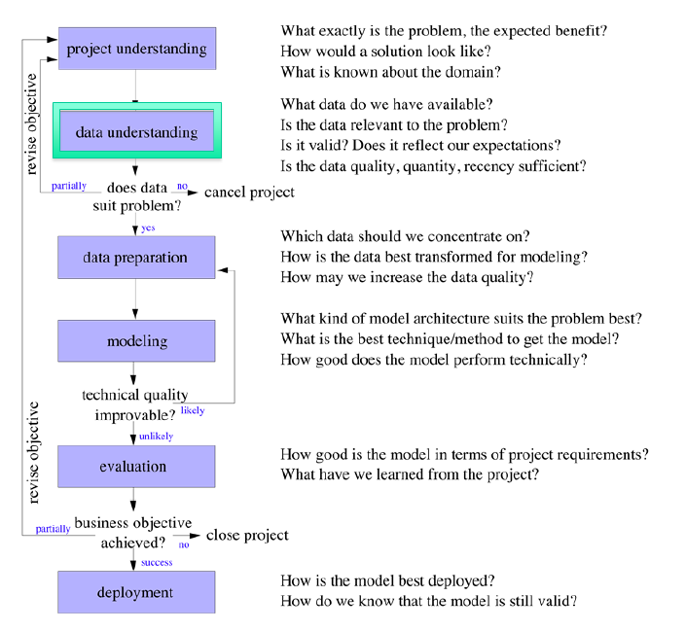
Data exploration – understanding

Slide 29
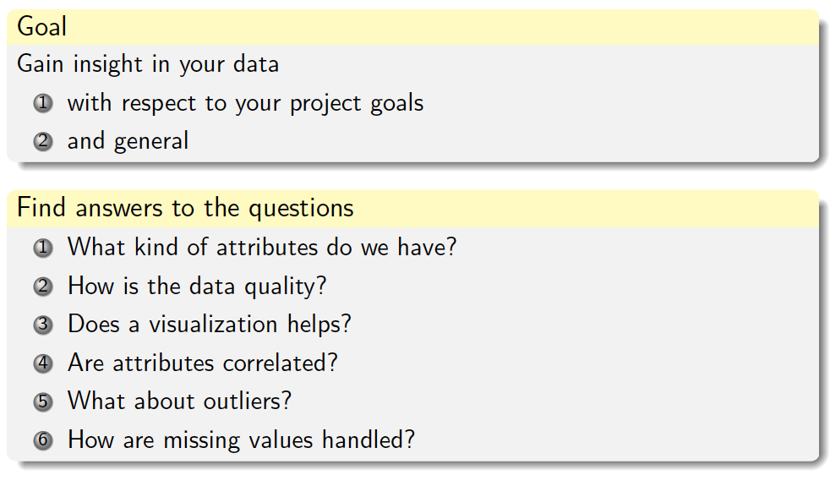
Questions in data understanding

Slide 30
Visualization
Visualization is the conversion of data into a visual or tabular format so that the characteristics of the data and the relationships among data items or attributes can be analyzed or reported.
Visualization of data is one of the most powerful and appealing techniques for data exploration.
Humans have a well developed ability to analyze large amounts of information that is presented visually
Can detect general patterns and trends
Can detect outliers and unusual patterns

Slide 31
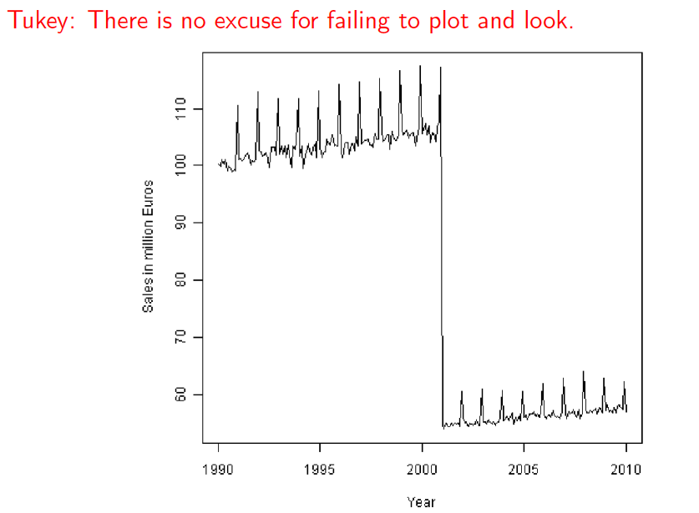
Data visualization

Slide 32
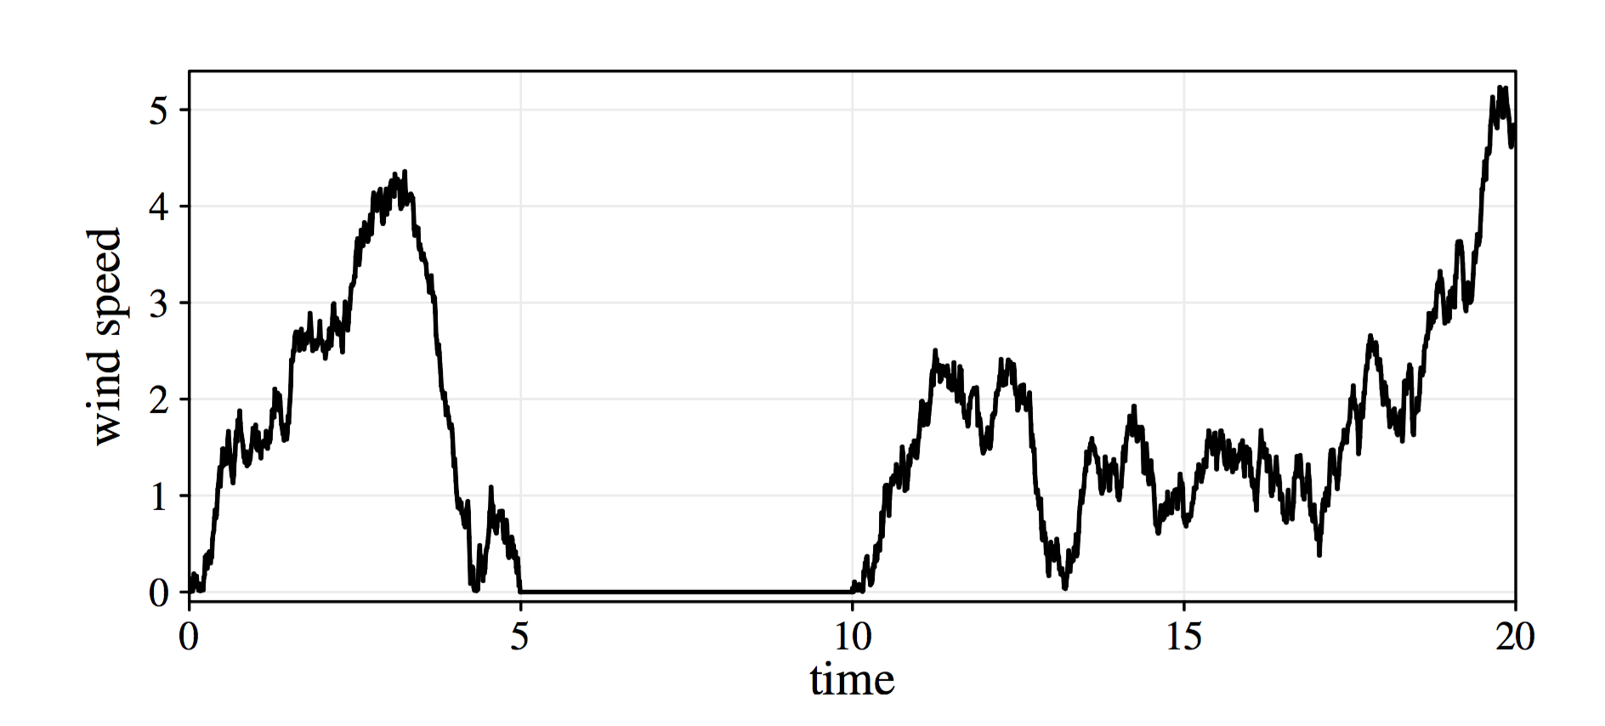
Data Visualization
The zero values might come from a broken or blocked sensor and might be consider as missing values.

Slide 33
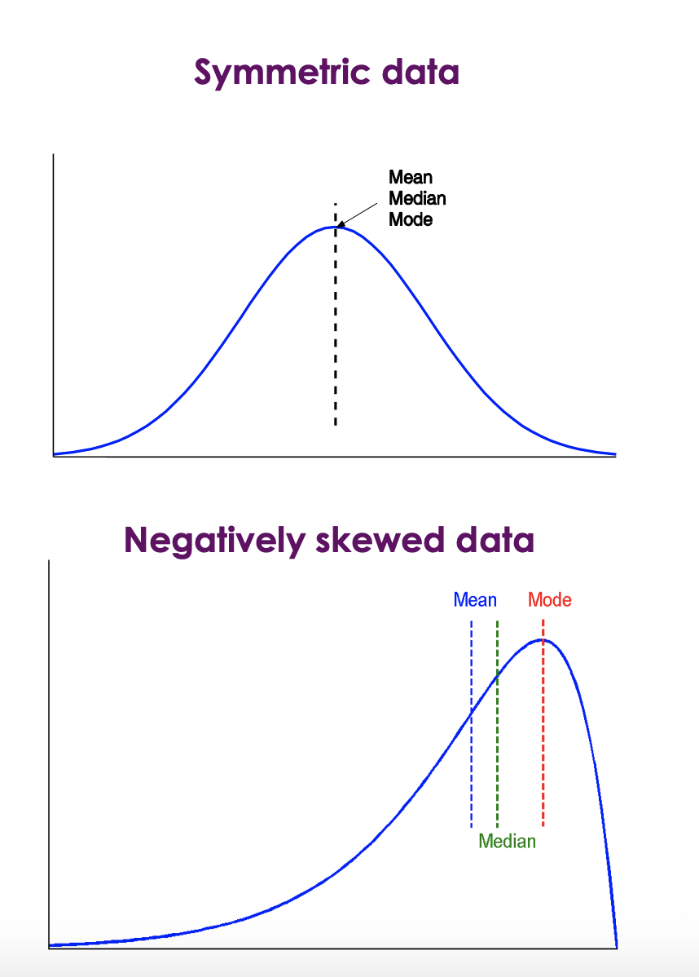
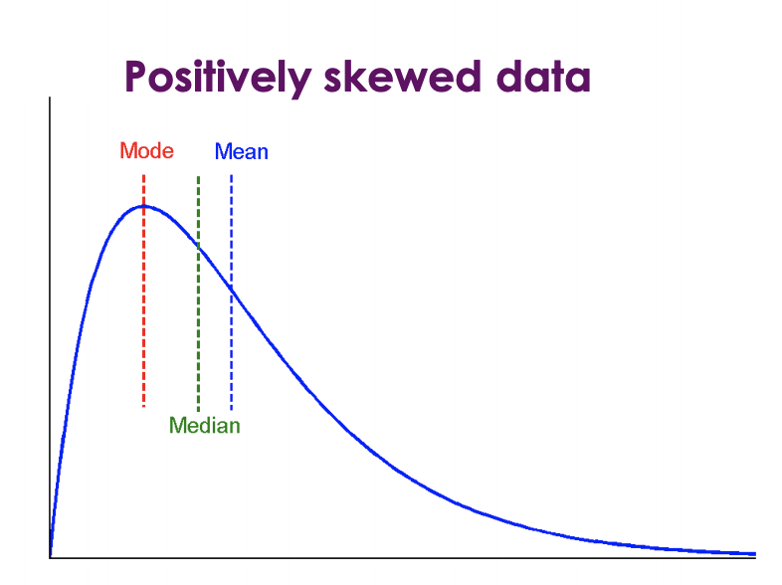
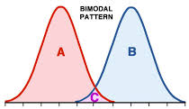
Observing Data Distribution

Slide 34
Example
Give an example of something having a positively skewed distribution
income is a good example of a positively skewed variable: there will be a few people with extremely high incomes, but most people will have incomes bunched together below the mean.
Give an example of something having a bimodal distribution
bimodal distribution has some kind of underlying binary variable that will result in a separate mean for each value of this variable.
One example can be human weight – the gender is binary and is a statistically significant indicator of how heavy a person is.

Slide 35
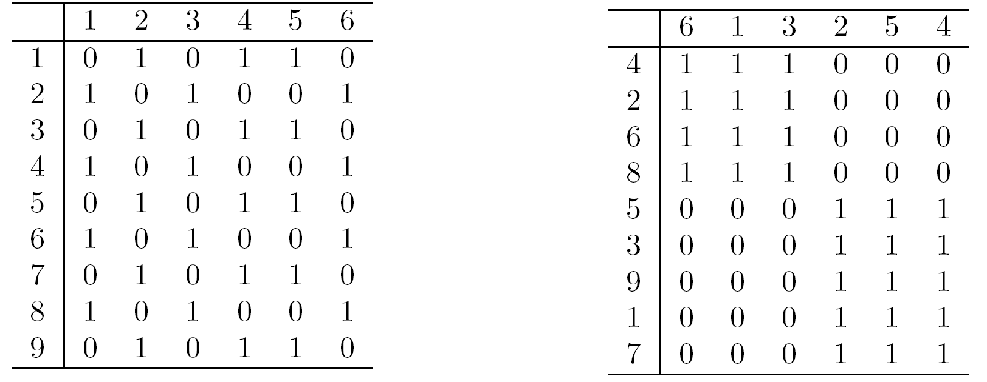
Arrangement
Is the placement of visual elements within a display
Can make a large difference in how easy it is to understand the data
Example:

Slide 36
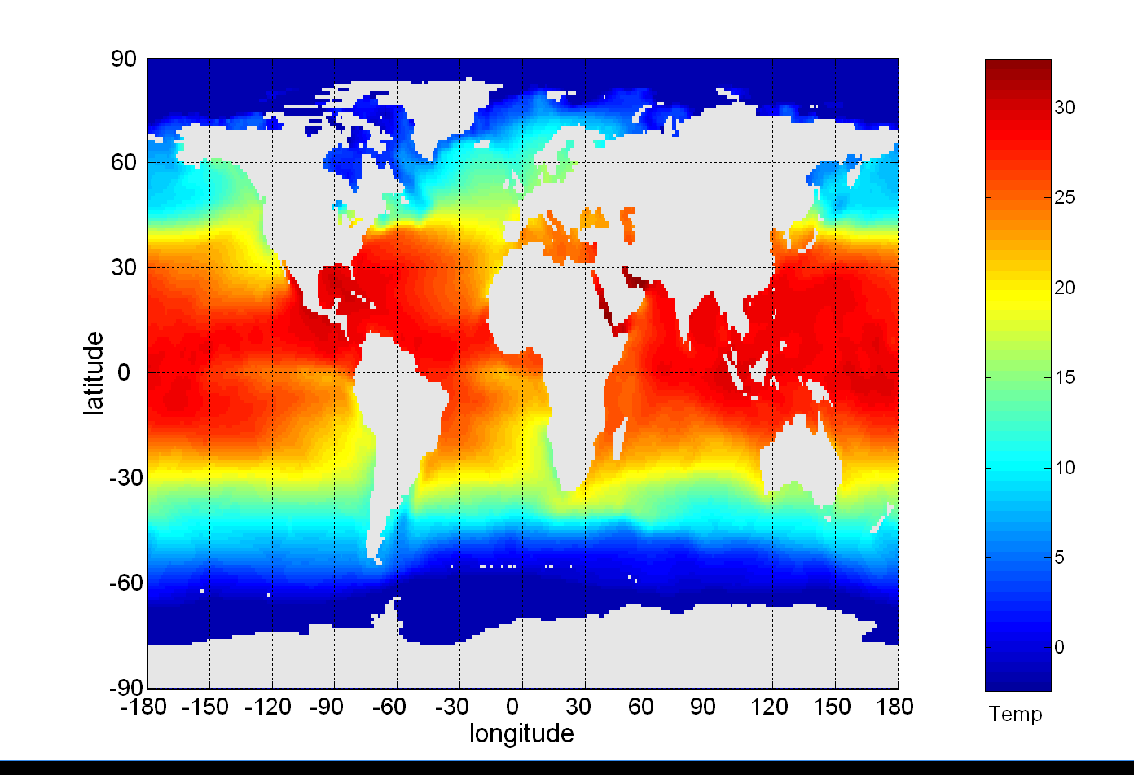
Example: Sea Surface Temperature
The following shows the Sea Surface Temperature (SST) for July 1982
Tens of thousands of data points are summarized in a single figure

Slide 37
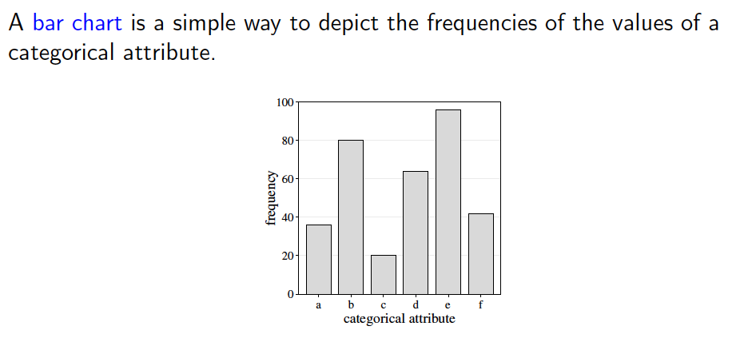
Bar charts for categorical attributes

Slide 38
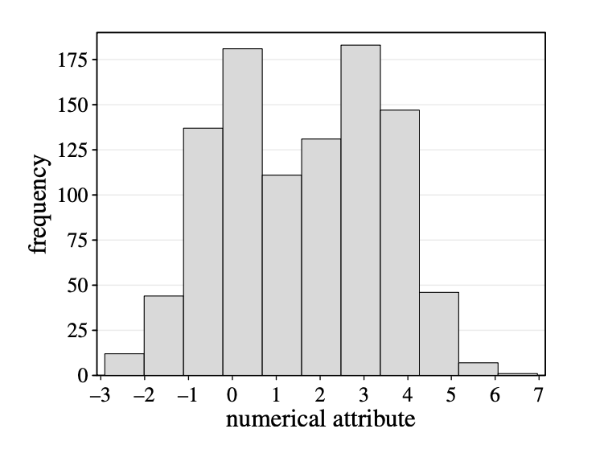
Histograms for Numerical Attributes
A histogram shows the frequency distribution for a numerical attribute.
The range of the numerical attribute is discretized into a fixed number of intervals (bins)
For each interval the (absolute) frequency of values falling into it is indicated by the height of a bar.

Slide 39
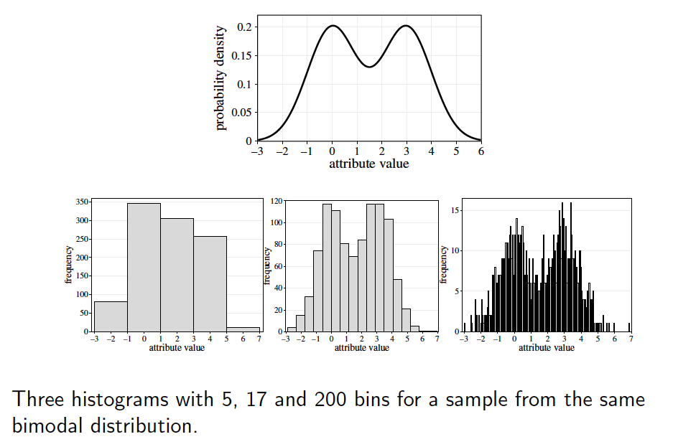
Histograms: number of bins

Slide 40
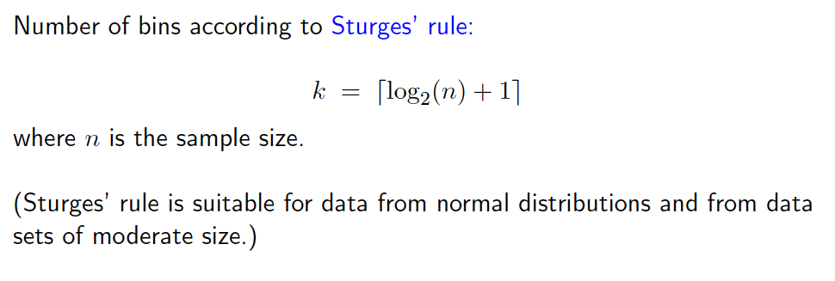
Histograms: number of bins

Slide 41
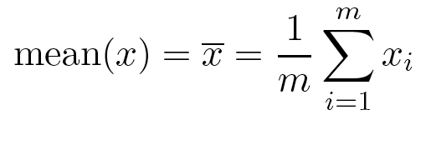
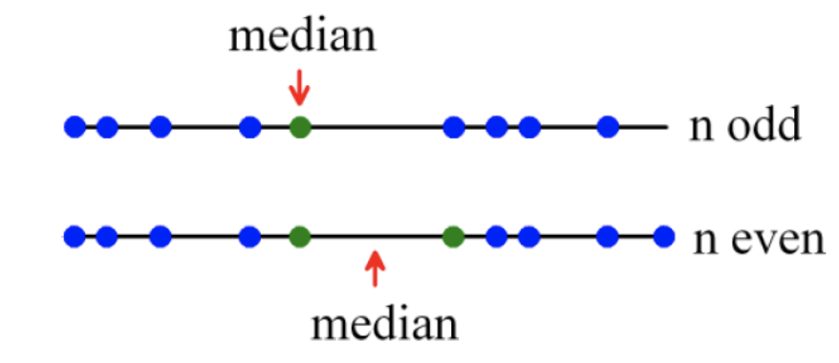
Measuring the Central Tendency
Mean
m is the sample size
A distributive measure can be computed by partitioning the data into smaller subsets
However, the mean is very sensitive to outliers
The median or a trimmed mean are also commonly used
Median
Middle value if odd number of values, or average of the middle two values otherwise
Mode
Value that occurs most frequently in the data
It is possible that several different values have the greatest frequency: Unimodal, bimodal, trimodal, multimodal
If each data value occurs only once then there is no mode

Slide 42
Measuring the Dispersion of Data
The degree in which data tend to spread is called the dispersion, or variance of the data
The most common measures for data dispersion are range, standard deviation, the five-number summary (based on quartiles), and the inter-quartile range
Range: The distance between the largest and the smallest values

Slide 43
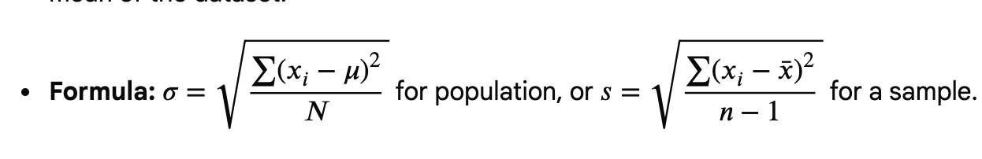
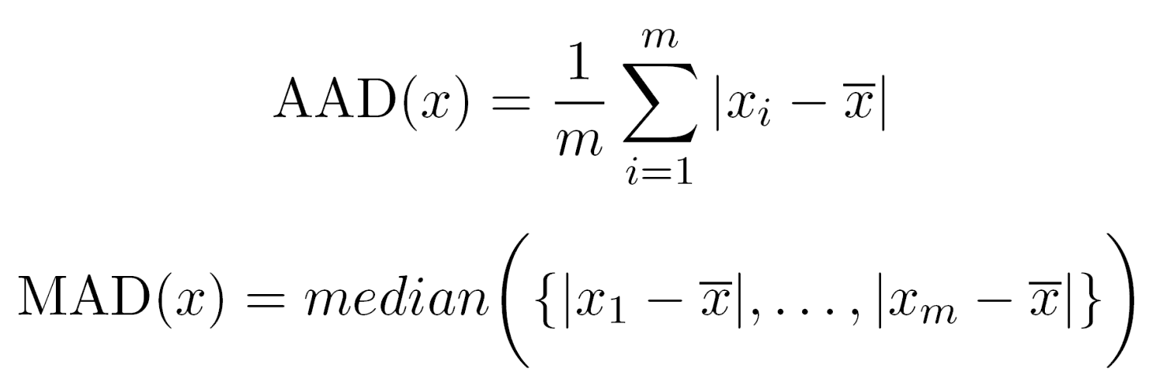
Measuring the Dispersion of Data
Variance
Standard deviation σ is the square root of variance σ²
σ measures spread about the mean and x should be used only when the mean is chosen as the measure of the center
σ=0 only when there is no spread, that is, when all observations have the same value. Otherwise σ>0
Because of outliers, other measures are often used:
absolute average deviation (AAD)
median average deviation (MAD)

Slide 44
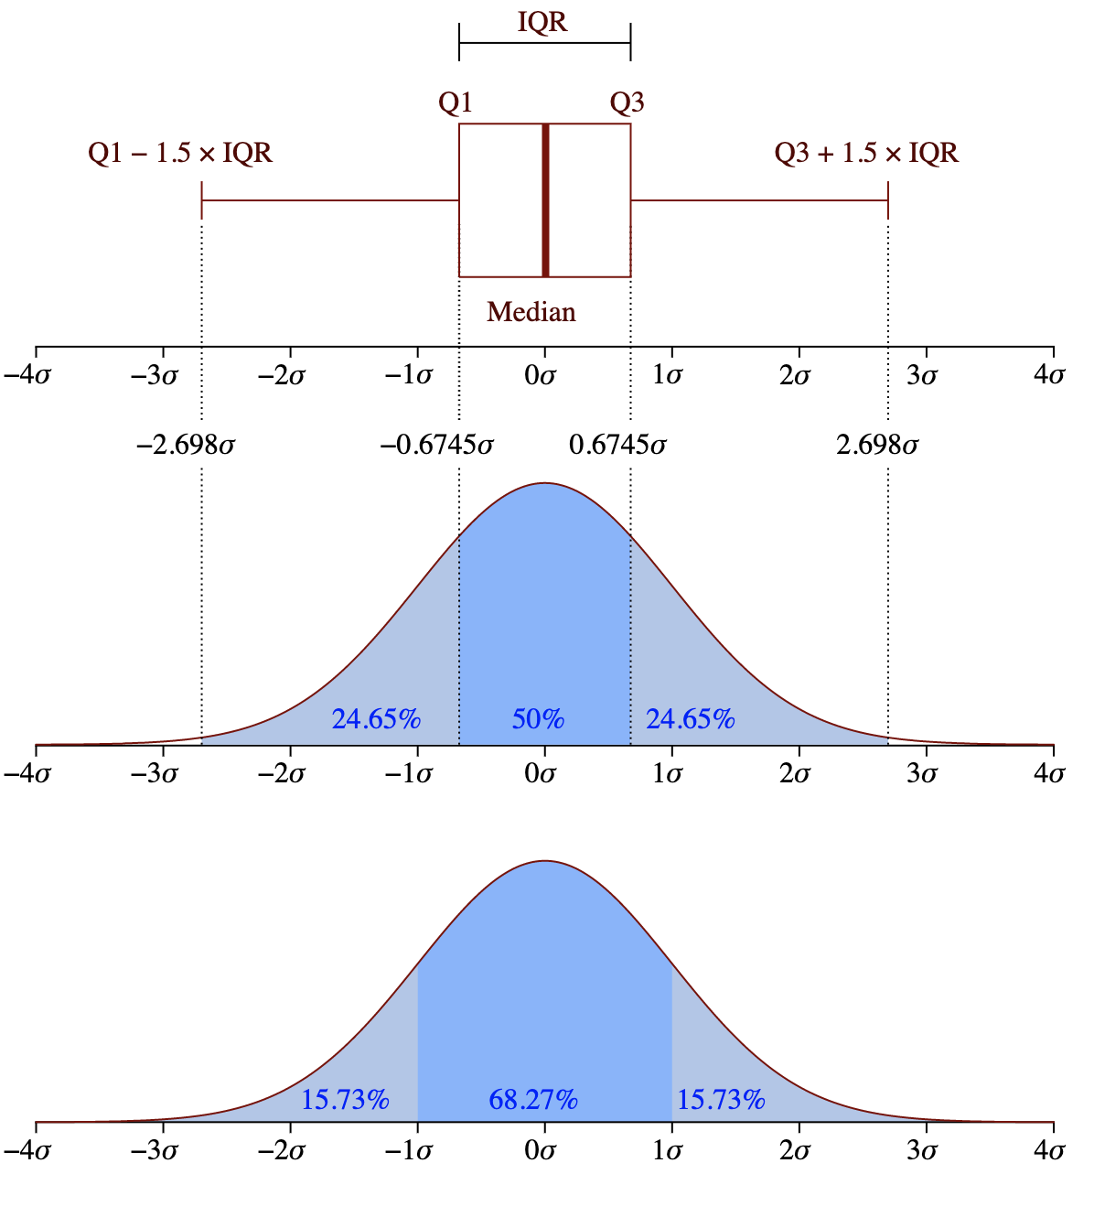
Box Plot: Five-number summary of a distribution
Data represented with a box
Whiskers: two lines outside the box extended to Minimum and Maximum
The ends of the box are at the
1st quartiles (25%-quantile)
3rd quartiles (75%-quantile)
Median: value in the middle (values in increasing order) is the 2nd quartile (50%-quantile)
The height of the box is Interquartile range (IQR): 3rd quartile - 1st quartile
p%-quantile (0 < p < 100): The value x s.t. p% of the values are smaller and 100-p% are larger.
Outliers: points beyond whiskers

Slide 45
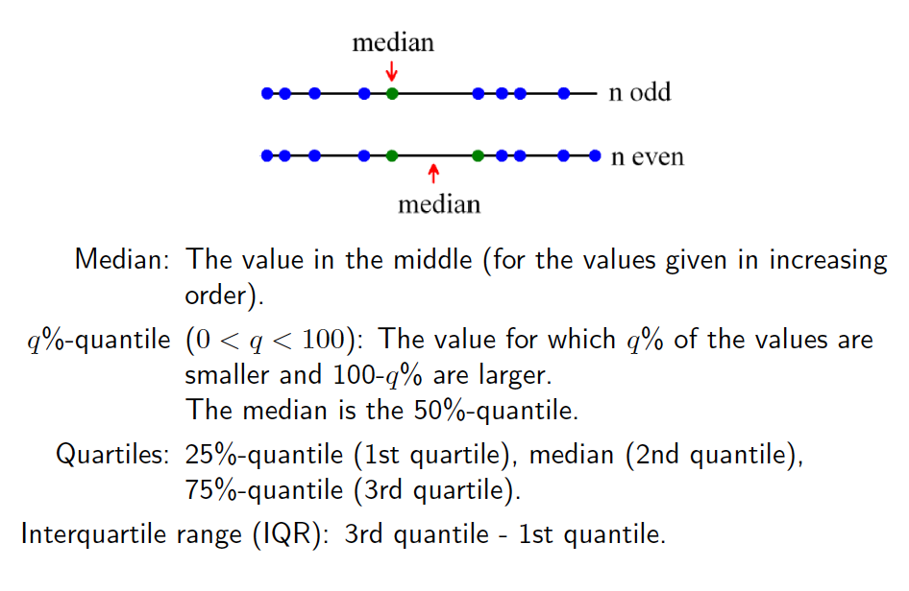
Reminder: quantiles, median, quartiles

Slide 46
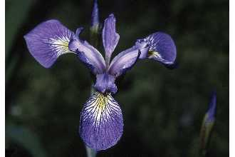
Iris Sample Data Set
Many of the exploratory data techniques are illustrated with the Iris Plant data set.
Can be obtained from the UCI Machine Learning Repository http://www.ics.uci.edu/~mlearn/MLRepository.html
From the statistician Douglas Fisher
Three flower types (classes):
Setosa
Virginica
Versicolour
Four (non-class) attributes
Sepal width and length
Petal width and length
Virginica. Robert H. Mohlenbrock. USDA NRCS. 1995. Northeast wetland flora: Field office guide to plant species. Northeast National Technical Center, Chester, PA. Courtesy of USDA NRCS Wetland Science Institute.

Slide 47
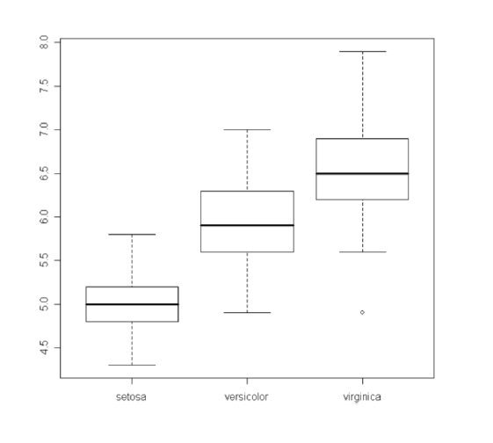
Boxplots

Slide 48
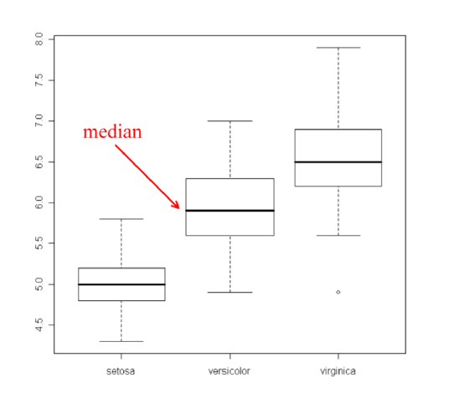
Boxplots

Slide 49
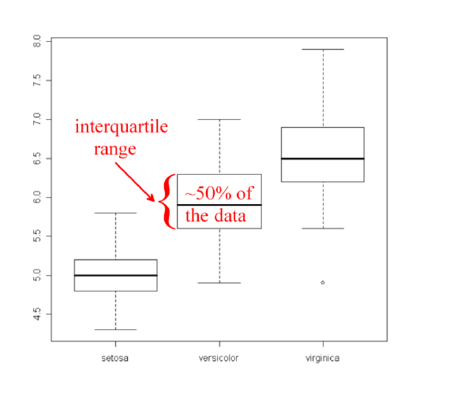
Boxplots

Slide 50
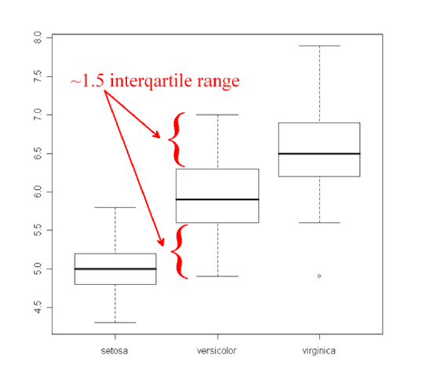
Boxplots

Slide 51
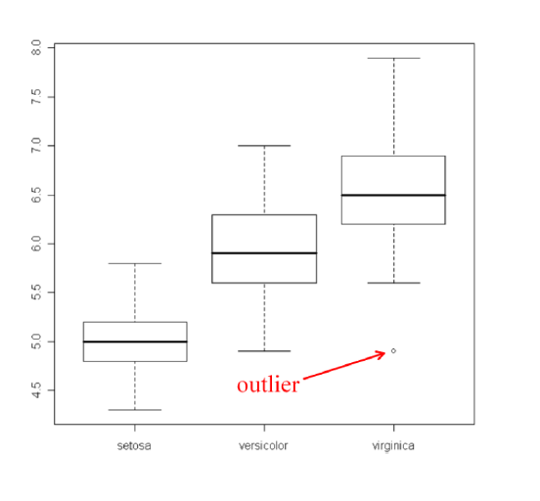
Boxplots

Slide 52
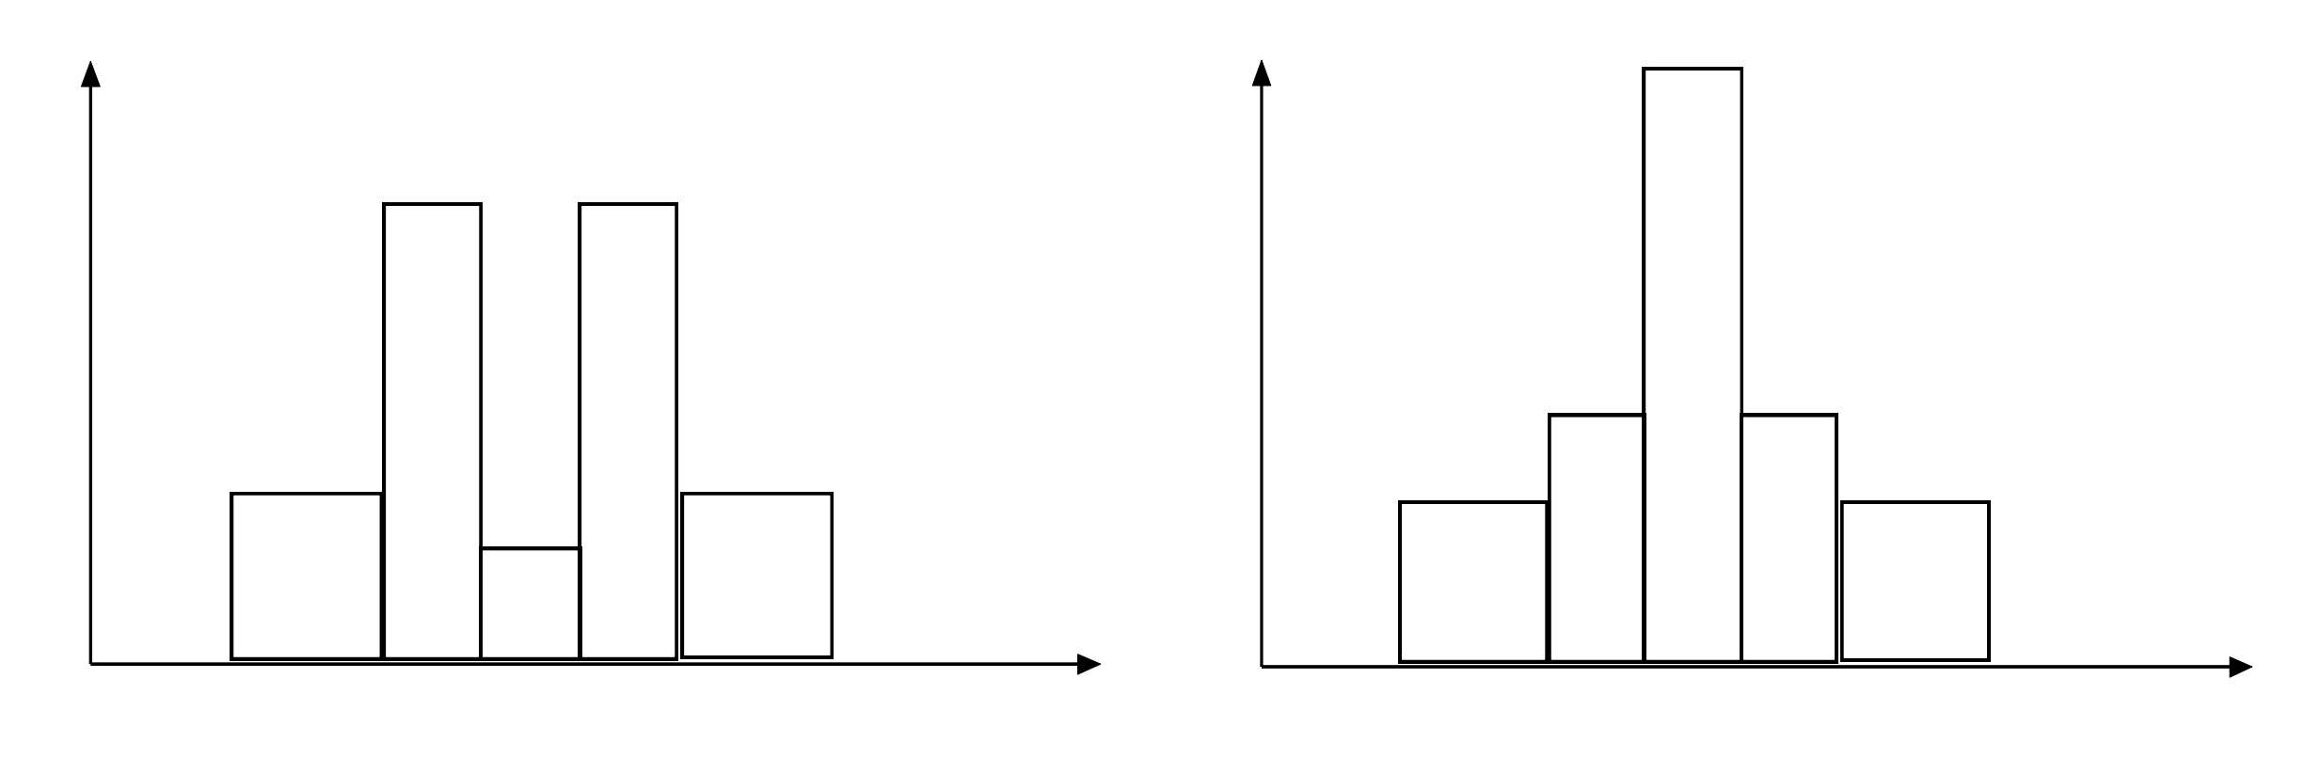
Histograms Often Tell More than Boxplots
The two histograms may have the same boxplot representation
The same values for: min, Q1, median, Q3, max
But they have rather different data distributions

Slide 53
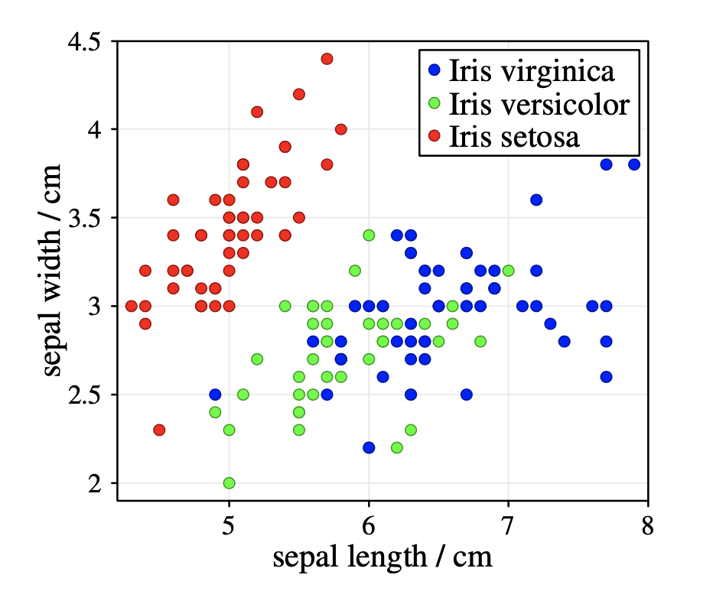
Scatter Plot
Provides a first look at bivariate data to see clusters of points, outliers, correlations
Each pair of values is treated as a pair of coordinates and plotted as points in the plane
Scatter plots can be enriched with additional information: Colour or different symbols to incorporate a third attribute in the scatter plot.

Slide 54
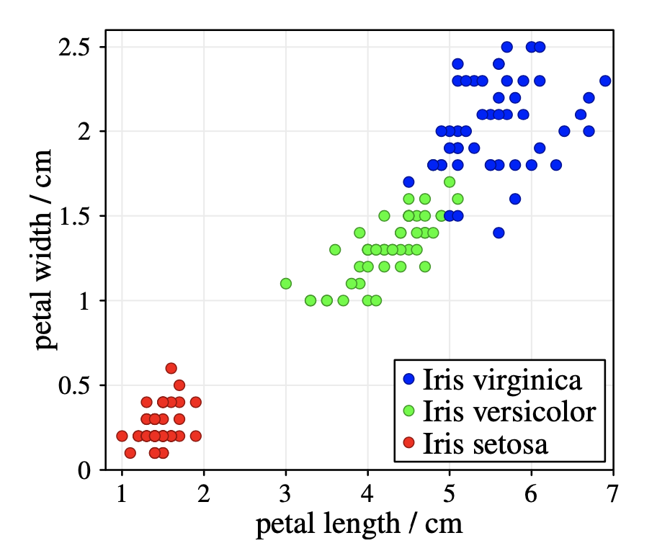
Scatter Plot
The two attributes petal length and width provide a better separation of the classes Iris versicolor and Iris virginica than the sepal length and width.

Slide 55
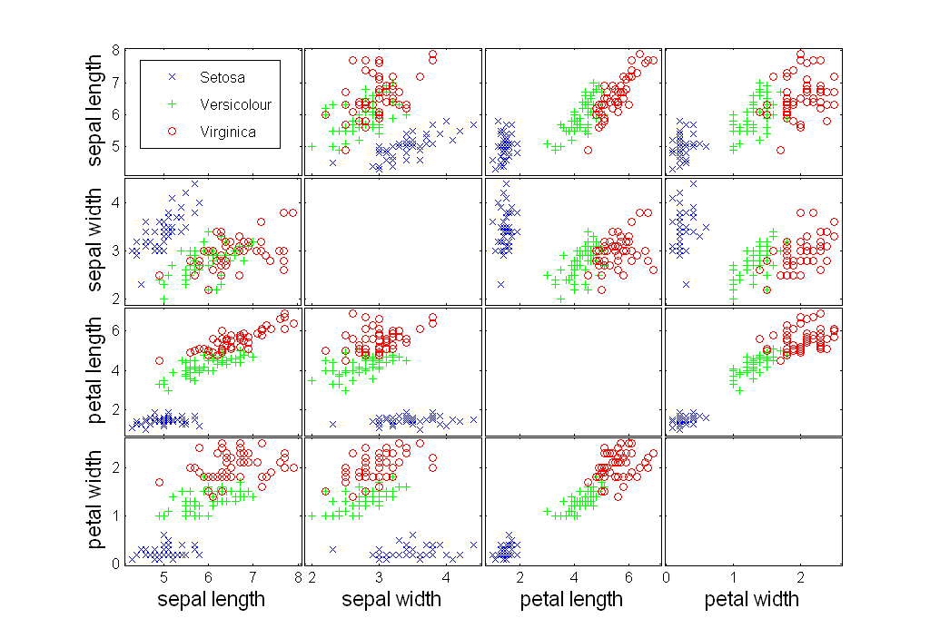
Scatter plots

Slide 56
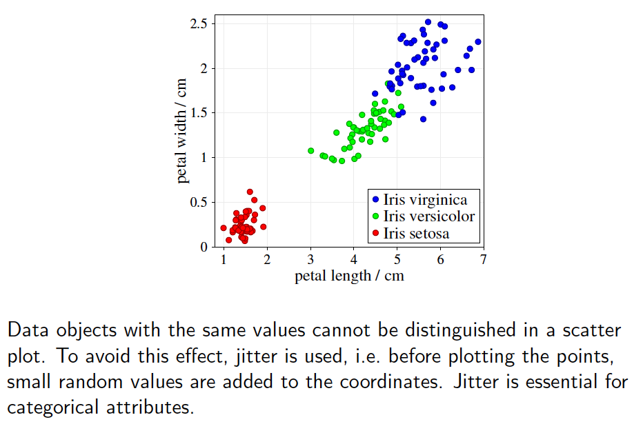
Scatter plots

Slide 57
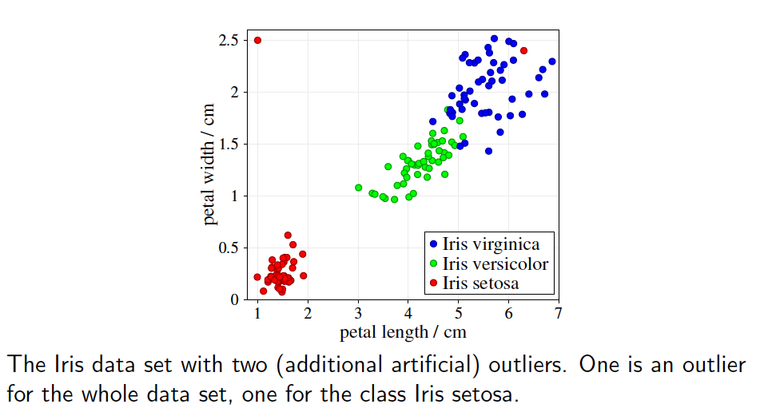
Scatter plots

Slide 58
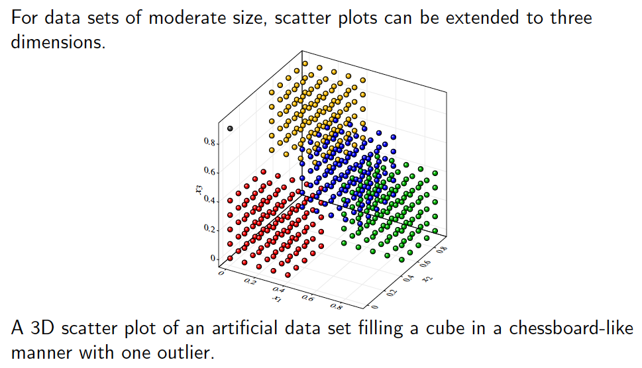
3D scatter plots

Slide 59
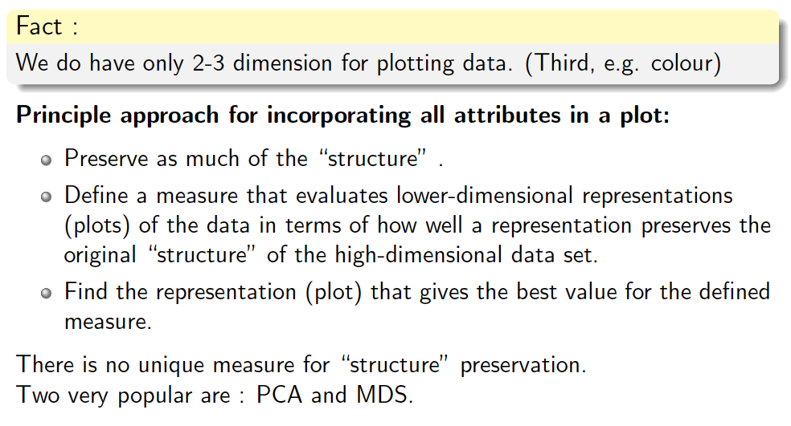
Higher-dimensional data

Slide 60
Visualization as a Test
When visualisations reveal patterns or exceptions, then there is “something” in the data set.
When visualisations do not indicate anything specific, there might still be patterns or structures in the data that cannot be revealed by the corresponding (simple) visualisation techniques.

Slide 61
Parallel Coordinates
Parallel Coordinates
Used to plot the attribute values of high-dimensional data
Instead of using perpendicular axes, use a set of parallel axes
The attribute values of each object are plotted as a point on each corresponding coordinate axis and the points are connected by a line
Thus, each object is represented as a line
Often, the lines representing a distinct class of objects group together, at least for some attributes
Ordering of attributes is important in seeing such groupings

Slide 62
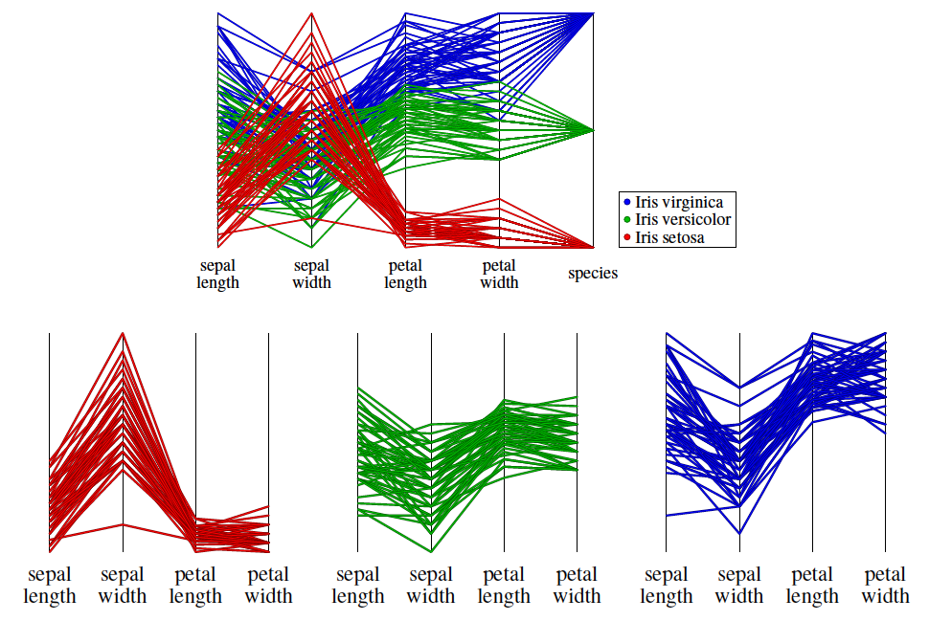
Parallel coordinates

Slide 63
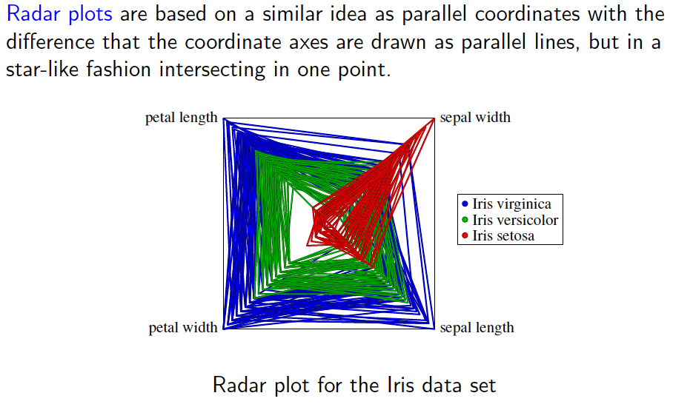
Radar plots

Slide 64
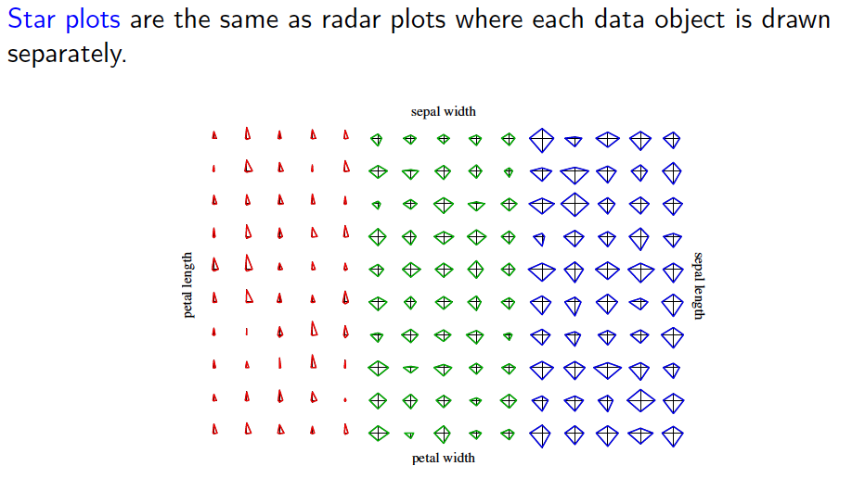
Star plots

Slide 65
Correlation Analysis
Correlation measures the linear relationship between objects
Captures similar behaviour of two attributes

Slide 66
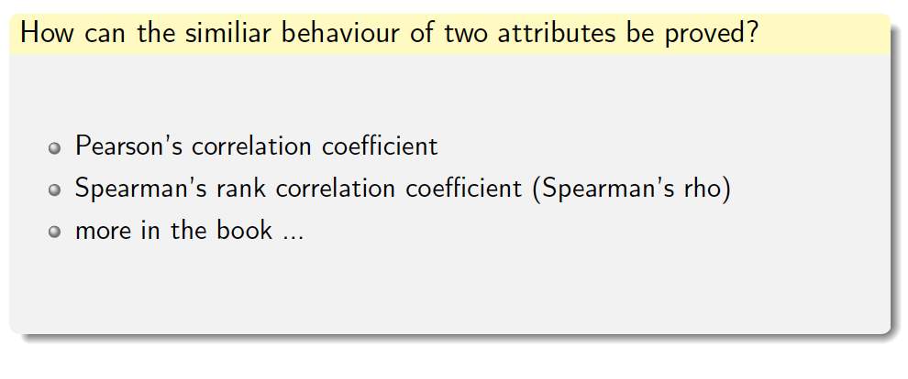
Correlation analysis

Slide 67
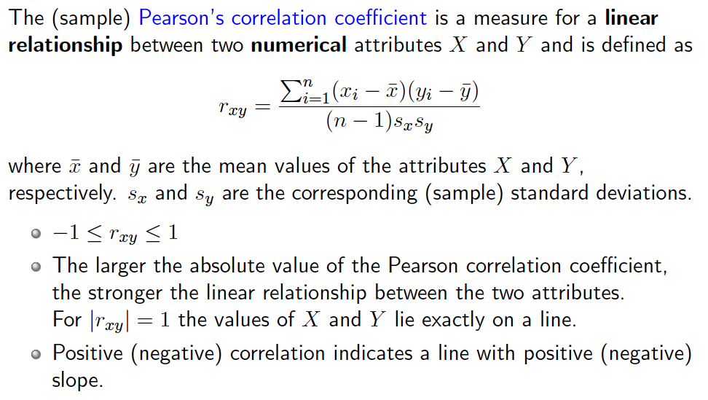
Pearson’s correlation coefficient

Slide 68
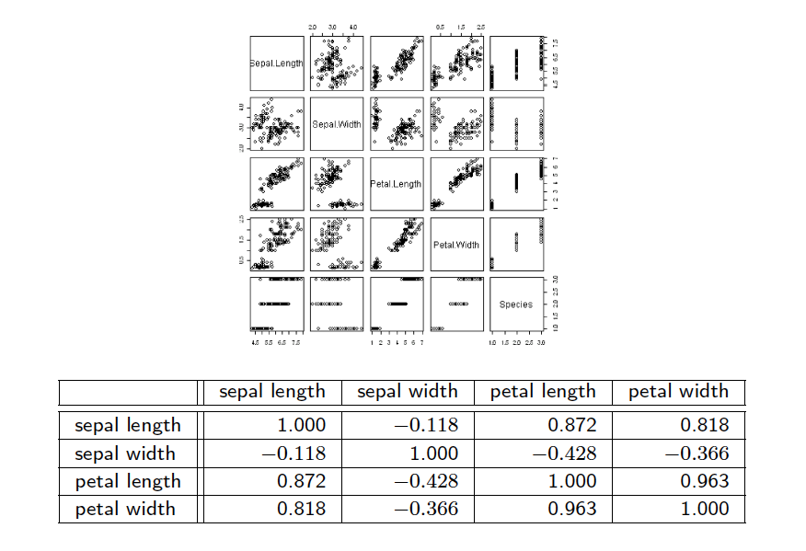
Pearson’s correlation coefficient

Slide 69
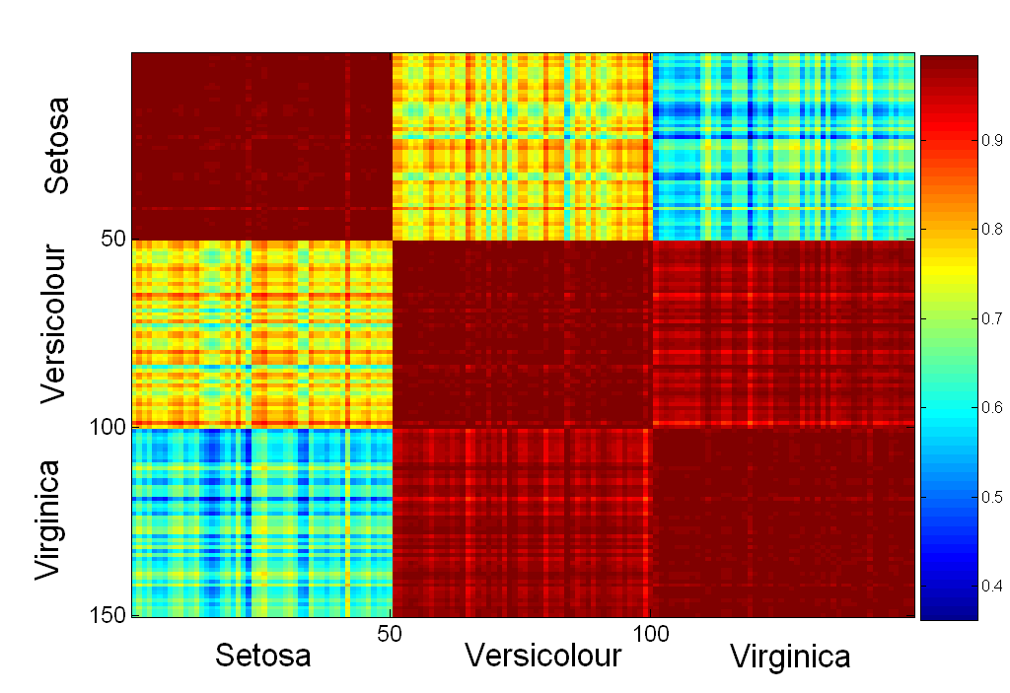
Visualization of the Iris Correlation Matrix

Slide 70
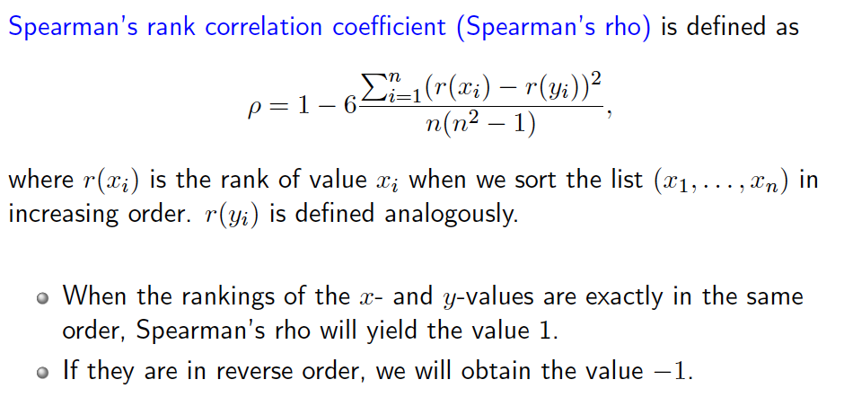
Spearman’s rank correlation coefficient

Slide 71
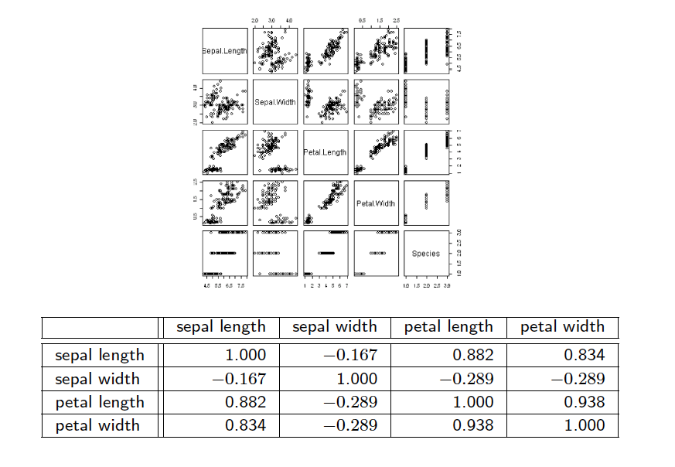
Spearman’s rank correlation coefficient

Slide 72
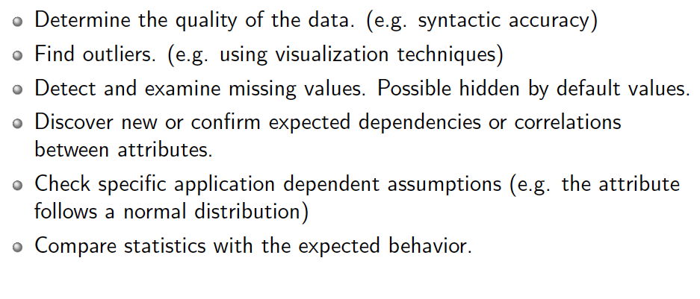
Checklist for data understanding

Slide 73
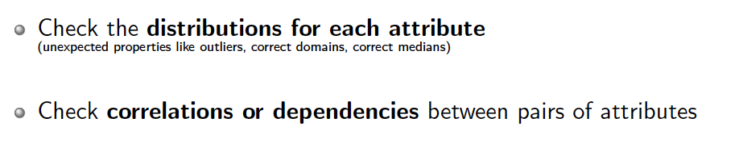
Checklist for data understanding: MUST DO

Slide 74
Data Quality
What kinds of data quality problems?
How can we detect problems with the data?
What can we do about these problems?
Examples of data quality problems:
Noise and outliers
missing values
duplicate data

Slide 75
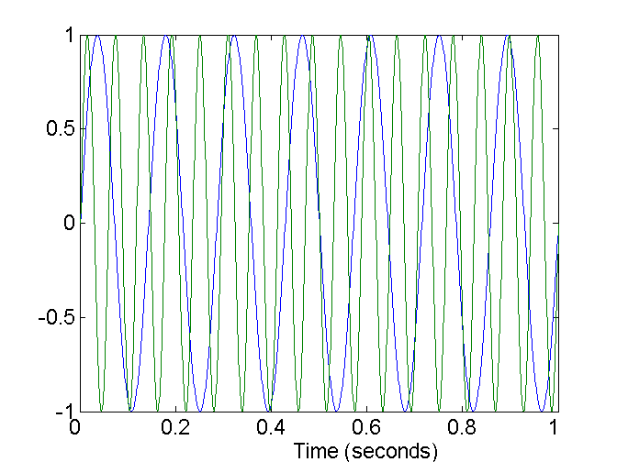
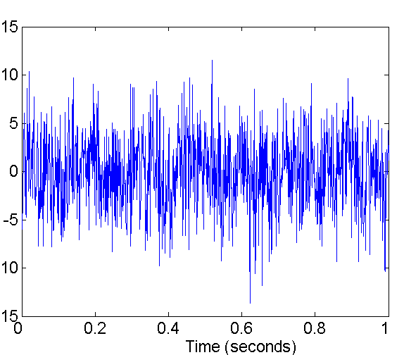
Noise
Noise refers to modification of original values
Examples: distortion of a person’s voice when talking on a poor phone and “snow” on television screen
Two Sine Waves
Two Sine Waves + Noise

Slide 76
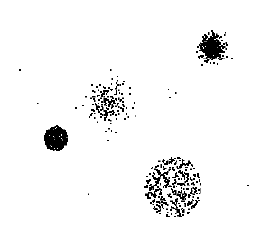
Outliers
Outliers are data objects with characteristics that are considerably different than most of the other data objects in the data set

Slide 77
Outlier Detection
Single attribute:
Categorical attributes: An outlier is a value that occurs with a frequency extremely lower than the frequency of all other values.
Numerical attributes: box plots
Multidimensional attribute:
Scatter plots for (visually detecting) outliers w.r.t. two attributes
PCA plots for (visually detecting) outliers
Cluster analysis techniques: Outliers are those points which cannot be assigned to any cluster.

Slide 78
Missing Values
Reasons for missing values
Information is not collected (e.g., people decline to give their age and weight)
Attributes may not be applicable to all cases (e.g., annual income is not applicable to children)
Handling missing values
Eliminate Data Objects
Estimate Missing Values
Ignore the Missing Value During Analysis
Replace with all possible values (weighted by their probabilities)

Slide 79
Duplicate Data
Data set may include data objects that are duplicates, or almost duplicates of one another
Major issue when merging data from heterogeous sources
Examples:
Same person with multiple email addresses
Data cleaning
Process of dealing with duplicate data issues

Slide 80
Data preparation

Slide 81
Data Preprocessing
Aggregation
Sampling
Dimensionality Reduction
Feature subset selection
Feature creation
Discretization and Binarization
Attribute Transformation

Slide 82
Aggregation
Combining two or more attributes (or objects) into a single attribute (or object)
Purpose
Data reduction
Reduce the number of attributes or objects
Change of scale
Cities aggregated into regions, states, countries, etc
More “stable” data
Aggregated data tends to have less variability

Slide 83
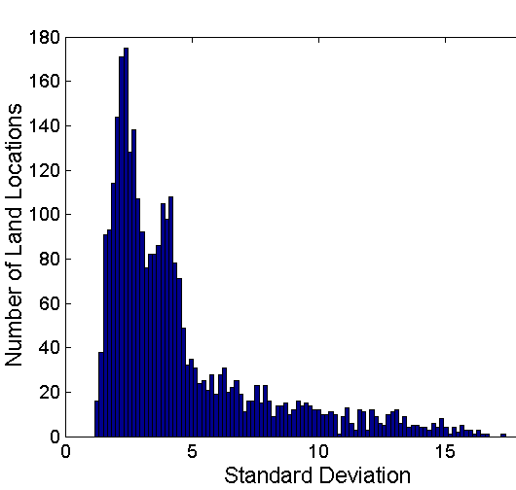
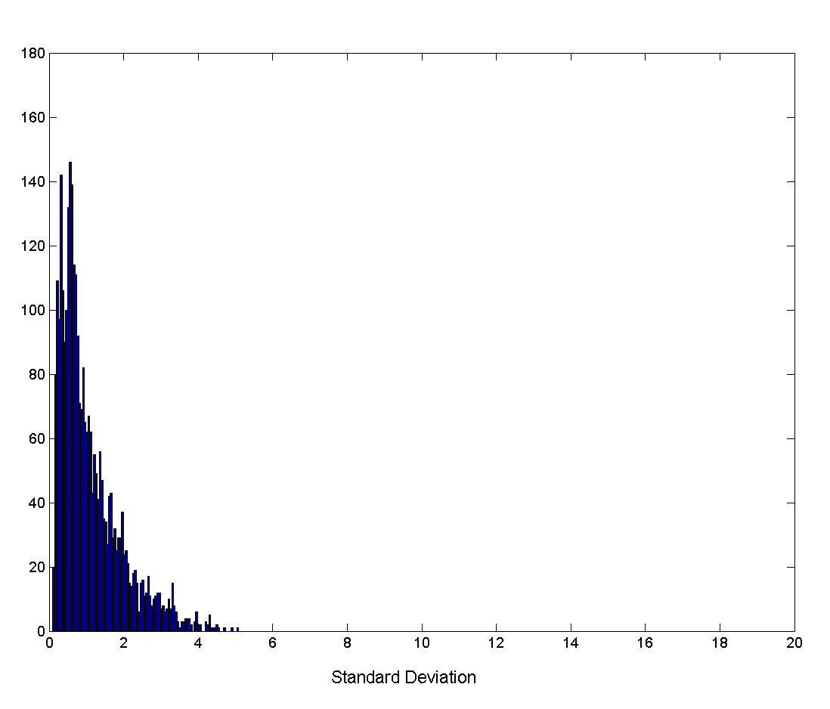
Aggregation
Variation of Precipitation in Australia
Standard Deviation of Average Monthly Precipitation
Standard Deviation of Average Yearly Precipitation

Slide 84
Sampling
Sampling is the main technique employed for data selection.
It is often used for both the preliminary investigation of the data and the final data analysis.
Statisticians sample because obtaining the entire set of data of interest is too expensive or time consuming.
Sampling is used in data mining because processing the entire set of data of interest is too expensive or time consuming.

Slide 85
Sampling …
The key principle for effective sampling is the following:
using a sample will work almost as well as using the entire data sets, if the sample is representative
A sample is representative if it has approximately the same property (of interest) as the original set of data

Slide 86
Types of Sampling
Simple Random Sampling
There is an equal probability of selecting any particular item
Sampling without replacement
As each item is selected, it is removed from the population
Sampling with replacement
Objects are not removed from the population as they are selected for the sample.
In sampling with replacement, the same object can be picked up more than once
Stratified sampling
Split the data into several partitions; then draw random samples from each partition

Slide 87



Sample Size
8000 points 2000 Points 500 Points

Slide 88


Sample Size
What sample size is necessary to get at least one object from each of 10 groups.

Slide 89

Curse of Dimensionality
When dimensionality increases, data becomes increasingly sparse in the space that it occupies
Definitions of density and distance between points, which is critical for clustering and outlier detection, become less meaningful
Randomly generate 500 points
Compute difference between max and min distance between any pair of points

Slide 90
Dimensionality Reduction
Purpose:
Avoid curse of dimensionality
Reduce amount of time and memory required by data mining algorithms
Allow data to be more easily visualized
May help to eliminate irrelevant features or reduce noise
Techniques
Principle Component Analysis
Singular Value Decomposition
Others: supervised and non-linear techniques

Slide 91
Dimensionality Reduction: PCA
Goal is to find a projection that captures the largest amount of variation in data
x₂
e
x₁

Slide 92
Dimensionality Reduction: PCA
Find the eigenvectors of the covariance matrix
The eigenvectors define the new space
x₂
e
x₁

Slide 93
Dimensionality Reduction: PCA

Slide 94
Feature Subset Selection
Another way to reduce dimensionality of data
Redundant features
duplicate much or all of the information contained in one or more other attributes
Example: purchase price of a product and the amount of sales tax paid
Irrelevant features
contain no information that is useful for the data mining task at hand
Example: students' ID is often irrelevant to the task of predicting students' GPA

Slide 95
Feature Subset Selection
Techniques:
Brute-force approch:
Try all possible feature subsets as input to data mining algorithm
Embedded approaches:
Feature selection occurs naturally as part of the data mining algorithm
Filter approaches:
Features are selected before data mining algorithm is run
Wrapper approaches:
Use the data mining algorithm as a black box to find best subset of attributes

Slide 96
Feature Creation
Create new attributes that can capture the important information in a data set much more efficiently than the original attributes
Three general methodologies:
Feature Extraction
domain-specific
Mapping Data to New Space
Feature Construction
combining features

Slide 97
Discretization
Unsupervised vs. Supervised
Global vs. Local
Static vs. Dynamic
Difficult Task
It is difficult to know a priori what the optimal discretization is.
You would need to know the actual distribution of the data

Slide 98
Disxcretization: why?
Original data can have extremely scattered continuous values
Discretized data may be easier to interpret
Discretized data distributions may have a 'Normal' shape.
Discretized data may still be extremely scattered
Elimination of the variable in question

Slide 99
Unsupervised Discretization
Caratteristiche:
Non usa etichetta le istanze
Il numero di intervalli (“bin”) è noto a priori
Tecniche di binning:
Natural binning → Intervalli di identica ampiezza
Equal Frequency binning → Intervalli di identica frequenza
Statistical binning → Uso di informazioni statistiche (Media, varianza, Quartili)

Slide 100
Discretization of quantitative attributes
Each value is replaced by the interval to which it belongs.
height: 0-150cm, 151-170cm, 171-180cm, >180cm
weight: 0-40kg, 41-60kg, 60-80kg, >80kg
income: 0-10ML, 11-20ML, 20-25ML, 25-30ML, >30ML
Problem: the discretization may be useless (see weight).

Slide 101

How to choose intervals?
Interval with a fixed “reasonable” granularity Ex. intervals of 10 cm for height.
Interval size is defined by some domain dependent criterion Ex.: 0-20ML, 21-22ML, 23-24ML, 25-26ML, >26ML
Interval size determined by analyzing data, studying the distribution or using clustering
50 - 58 kg
59-67 kg
> 687 kg

Slide 102
Natural Binning
I sort the values, then divide the range of values into k parts of the same size
element x_{j} belongs to i if
x_{j} ∈ [x_{min} + iδ, x_{min} + (i+1)δ)
Can produce very unbalanced distributions

Slide 103
Example
δ =(160-100)/4 = 15
classe 1: [100,115)
classe 2: [115,130)
classe 3: [130,145)
classe 4: [145, 160]

Slide 104
Equal Frequency Binning
I order and count the elements, then define k intervals of f elements, where:
(N is the number of elements of the datasets)
Element x_{i} belongs to class j is
j × f ≤ i < (j+1) × f
Not always suitable for highlighting interesting correlations

Slide 105
Example
f = 12/4 = 3
classe 1: {100,110,110}
classe 2: {120,120,125}
classe 3: {130,130,135}
classe 4: {140,150,160}

Slide 106
How many intervals?
If too few
=> loss of distribution information
If too many
=> scatters the values and does not manifest the shape of the distribution
The optimal number C of intervals is a function of the number N of elements (Sturges, 1929).
The optimal interval width depends on the variance and the number of data (Scott, 1979).

Slide 107




Discretization
Data
Equal interval width
Equal frequency
Clustering

Slide 108
Supervised Discretization
Caratteristiche:
La discretizzazione è riferita ad una etichetta presente nei dati.
Il numero di classi non è noto a priori
Tecniche:
ChiMerge
Discretizzazione basata sull’Entropia
Discretizzazione basata sui percentili

Slide 109

Attribute Transformation
A function that maps the entire set of values of a given attribute to a new set of replacement values such that each old value can be identified with one of the new values
Simple functions: x^{k}, log(x), e^{x}, |x|
Standardization and Normalization

Slide 110
Data Transformation
Data with errors or incomplete data
Poorly distributed data
Strong data sparsity
Strong data asymmetry
Many peaks
Data transformation can alleviate these problems

Slide 111
Data transformation
Dfine a transformation T on attribute X:
Y = T(X)
such that:
Y preserves «relavant» information of X
Y remove at least one of the problems of X
Y is more “useful” di X

Slide 112
GOALS
Main goals
stabilising variances
normalising variable distributions
Linearising relationships between variables
Secondary purposes
to simplify the processing of data with undesirable characteristics
to represent the data in a scale considered more suitable.

Slide 113
Why normality, linearity, etc?
Many statistical methodologies require linear correlations, normal distributions, absence of outliers
Many data mining algorithms have the ability to automatically deal with non-linearities and non-normalities.
Algorithms work better if these problems are handled.

Slide 114
Improve interpretability `
Linear transformations
1€ = 1936.27 Lit.
p=1, a= 1936.27 ,b =0
ºC= 5/9(ºF -32)
p = 1, a = 5/9, b = -160/9

Slide 115
Normalization
min-max normalization
z-score normalization
normalization with decimal scaling
dove j è il più piccolo intero tale che Max(| |)<1

Slide 116
Variance stabilisation
Logaritmic transformation
Applies to positive values
homogenises variances of 'long tail' distributions
E.g.: normalises seasonal peaks

Slide 117
Logarithmic transformation
Too sparse data!!!

Slide 118
Logarithmic transformation

